Slide 1





Salesforce Apex Hours For Students
Build a Custom
UI using LWC
Speaker
Date
Venue/Link
Amit Singh
Feb 26, 2020 6:00 PM IST
http://bit.do/ApexHoursDev
#SalesforceApexHours
www.apexhours.com
#SalesforceApexHours

Slide 2
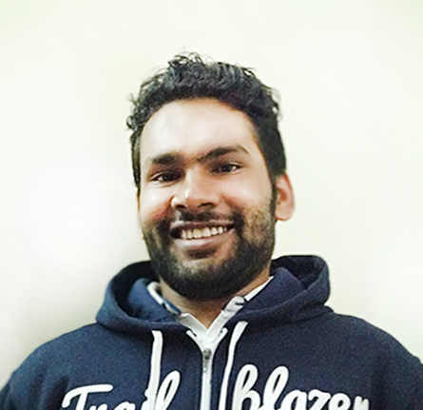


Our Speaker
Amit Singh
Certified Salesforce Application Architect
Community Leader & Speaker
Mulesoft Leader
Lightning & Analytics Champion
11x Certified
7X Ranger
@cloudyamit
/in/simplyamit

Slide 3
Housekeeping rules
Please be muted if you are not speaking
No question is silly question so keep adding the question in chat window.
We have reserved time for Q&A at the end of the session

Slide 4
Agenda
Working with Events in LWC
Access Salesforce Data in LWC
Using Custom Lightning Component in Lightning Experience
Navigation in LWC
Q & A

Slide 5
Communication between LWC
We can communicate with components in 2 ways
Using Events
Using api property or api function
LWC
Parent to Child
Child to Parent

Slide 6
Parent to Child
Change Data or button click
Parent Component
Child Component
Perform action in Child component

Slide 7

Demo 1
Parent to Child

Slide 8
Child to Parent
Handle in parent
const event = new CustomEvent('event-name', {
detail: { }
});
this.dispatchEvent(event);
Fire/dispatch from child

Slide 9
Demo 2
Child to Parent

Slide 10
Accessing Data in LWC from Database
Using apex class
Using Lightning Data Service

Slide 11
Demo 3
Working with Salesforce Data

Slide 12
Use LWC in lightning Experience
Home Page
Record Page
App Page
Custom Tab
Lightning Flow

Slide 13
Demo 4

Slide 14
What to do next
Events in Salesforce Blog post
Play with Events in LWC SFDCPanther Video
Build Lightning Web Components Trailhead
All the best

Slide 15
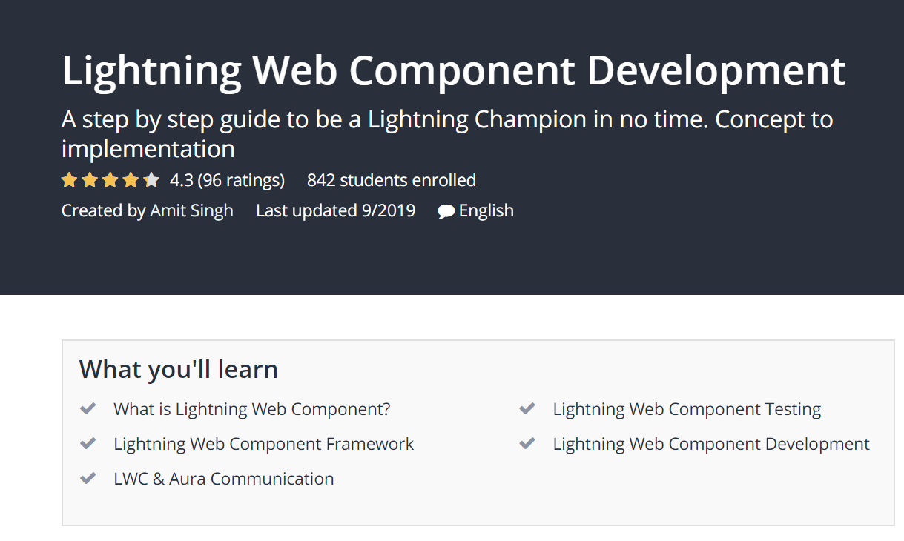
Where to Go From Here
Email – sfdcpanther@gmail.com
Twitter - @cloudyamit
LinkedIn - /in/simplyamit

Slide 16

Program Announcement
We are excited to announce that we are going to start the Mock Interviews for Students by SFDCPanther.

Slide 17
Details of Competitions
You all ( Who registered for the program ) will be getting an email which will have all the details of the competitions. If you have not registered send your email to amit.salesforce21@gmail.com and you will be included in the mail chain
Once you have completed the assignment tweet & tag us ( @amit_sfdc , @cloudyamit, @jigarshah189) with the following hashtags #SalesforceApexDevHoursStudent #ApexDevHoursForStudent #DevApexHoursForStudent

Slide 18

Questions? …

Slide 19





Where to go from here
#SalesforceApexHours @ApexHours
www.ApexHours.com
https://trailblazercommunitygroups.com/farmington-mi-developers-group/
https://www.youtube.com/channel/UChTdRj6YfwqhR_WEFepkcJw/videos
https://www.facebook.com/FarmingtonHillsSfdcdug/?ref=bookmarks

